Slide 1

Exception Handling Fundamentals
&
Advanced Techniques
Notes:
Hello everyone, welcome to our session on "Exception handling Fundamentals and Advanced Techniques”, In this presentation we will cover Introduction and Implementation of Exceptions, Fundamentals- Terminology and Types, Handling Exceptions, Advanced Techniques- Nested Blocks and Chained Exceptions,Advanced Techniques- Multithreading, Realworld Examples and Pitfalls and Best practices and Guidelines.

Slide 2

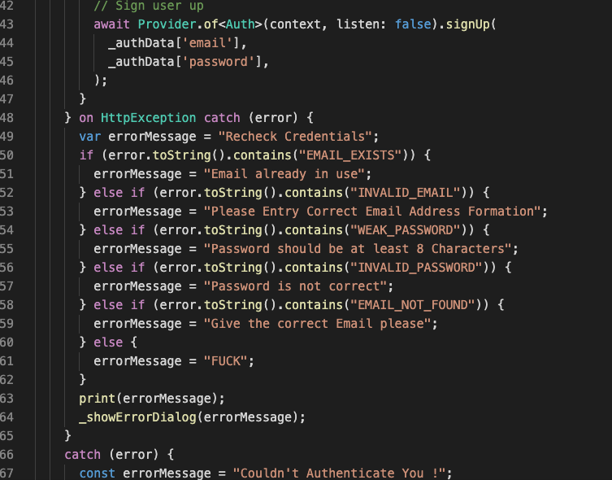
Introduction & Importance
What are exceptions?
Anomalous conditions that disrupt program flow.
Can be caused by various factors (e.g., user input, resource errors, network issues).
Importance of exception handling
Ensures program stability and prevents crashes.
Allows for graceful handling of errors.
Improves application robustness and user experience.
Benefits of proper exception handling
Increased code quality and maintainability.
Easier debugging and troubleshooting.
Improved error reporting and logging.
Provides a more predictable and reliable program execution.
Notes:
Introduction & Importance:
What are exceptions?: We'll begin by defining exceptions and their significance in software development.
Importance of exception handling: Discussing why proper exception handling is essential for robust and reliable software.
Benefits of proper exception handling: Exploring the advantages of implementing effective exception handling practices.

Slide 3
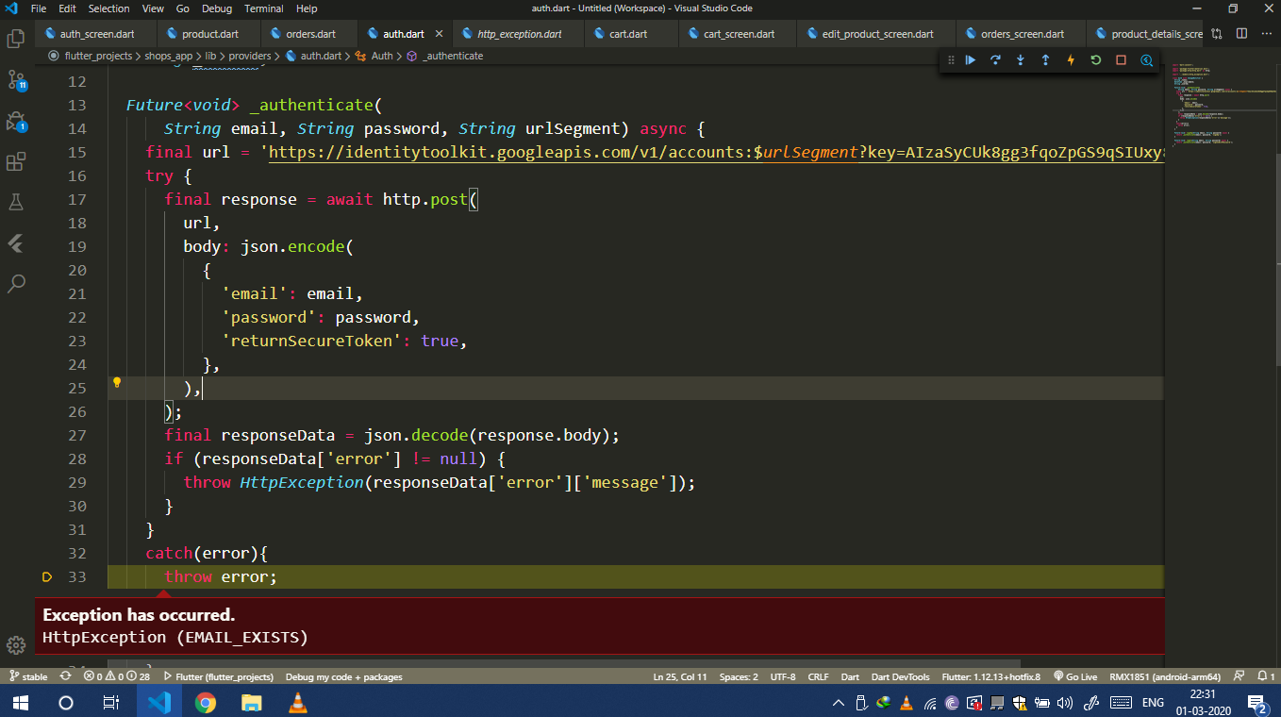
Fundamentals - Terminology & Types
Key terms:
try-catch block
finally block
throw
throws
Types of exceptions
Checked
Unchecked
Notes:
Key terms:
try-catch block: defines code blocks for handling specific exceptions.
finally block: executes regardless of exceptions (e.g., resource cleanup).
throw: explicitly throws an exception.
throws: declares the types of exceptions a method may throw.
Types of exceptions:
Checked: require explicit handling by the programmer.
Unchecked: not required to be handled but recommende.

Slide 4
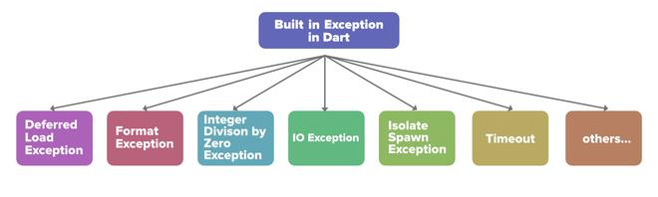
Handling Exceptions
Specific vs. General exceptions:
Specific: targeted handling for defined exceptions (e.g., FileNotFoundException).
General: catch-all for unexpected or unknown errors.
Creating custom exceptions:
Define your own exceptions for specific situations.
Provides more granular error handling and information.
Rethrowing exceptions:
Propagate an exception caught in a catch block.
Allows handling the exception at a higher level.
Notes:
Specific vs. General exceptions: Discussing the merits of handling specific exceptions versus catching general exceptions.
Creating custom exceptions: Exploring the process of creating custom exception classes tailored to specific application requirements.
Rethrowing exceptions: Explaining the concept of rethrowing exceptions and its use cases in exception propagation.

Slide 5
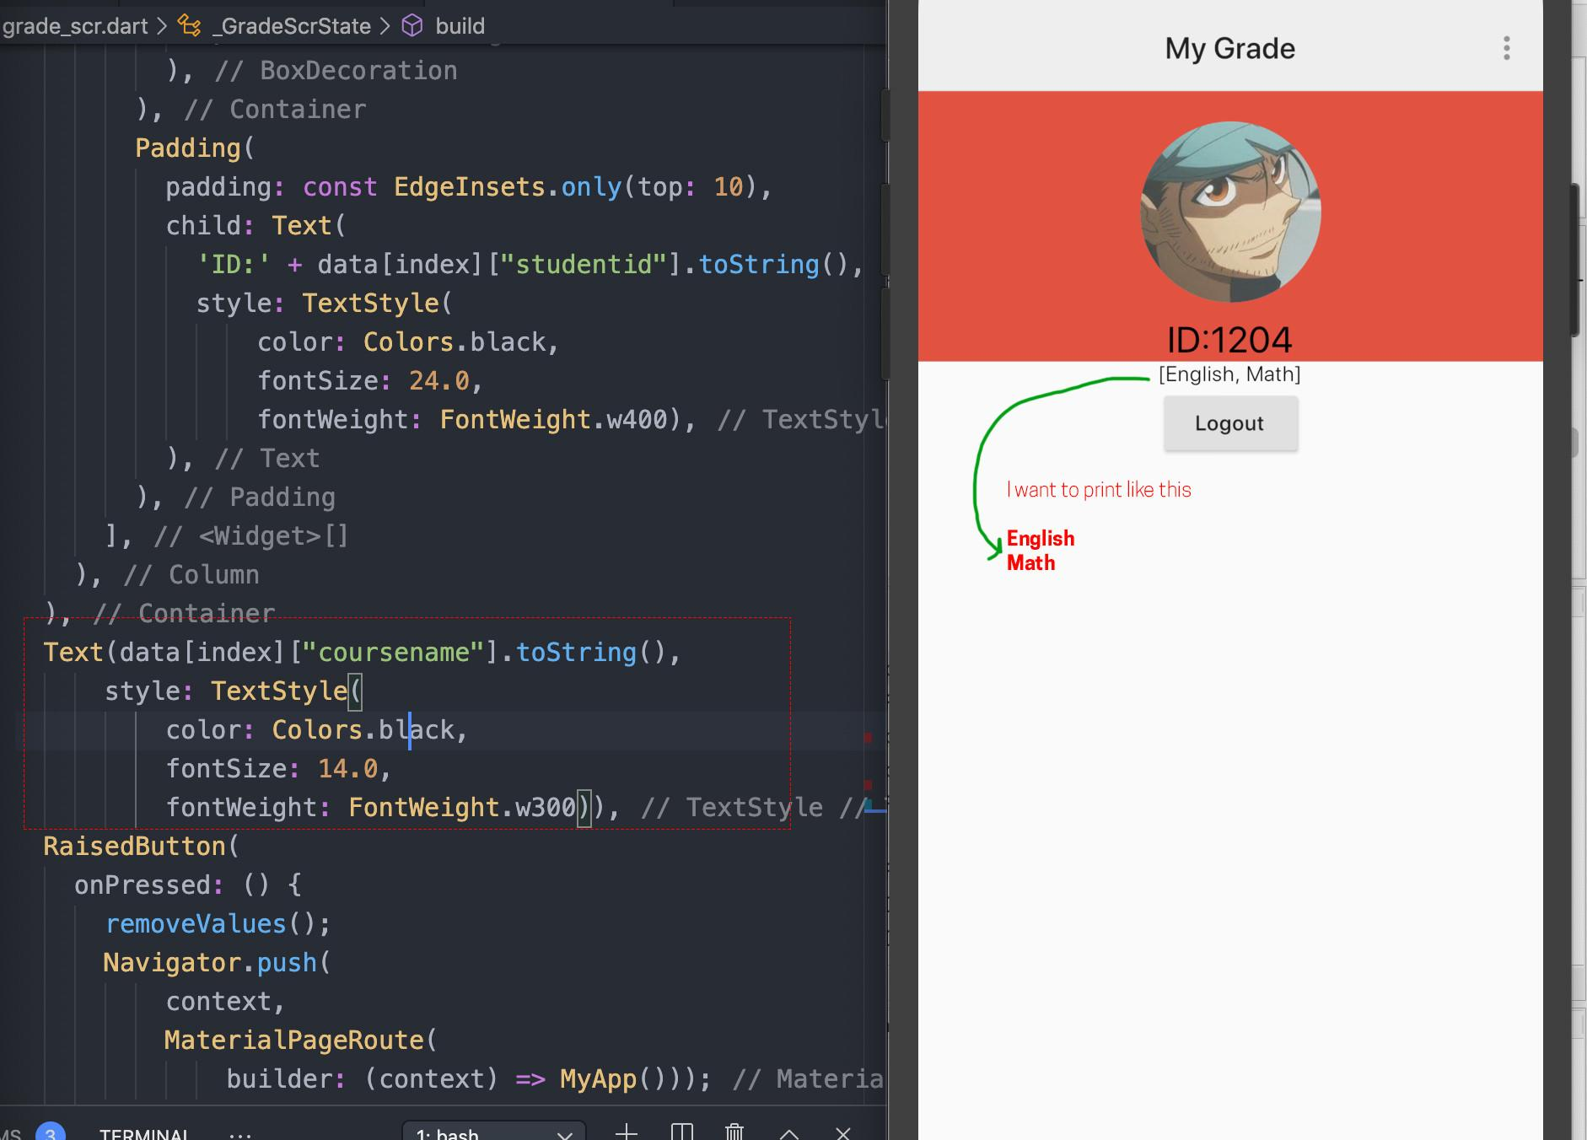
单击此处添加标题
Advanced Techniques - Nested Blocks & Chained Exceptions
Nested try-catch blocks:
Multiple try-catch blocks nested inside each other.
Provides finer-grained control over exception handling for specific code sections.
Chained exceptions:
Link exceptions together to trace their origin and cause.
Helpful for debugging and understanding the root cause of an error.
Notes:
Nested try-catch blocks: Demonstrating how nested try-catch blocks offer finer control over exception handling in complex scenarios.
Chained exceptions: Discussing the concept of chaining exceptions to track error origins and provide comprehensive error information.

Slide 6
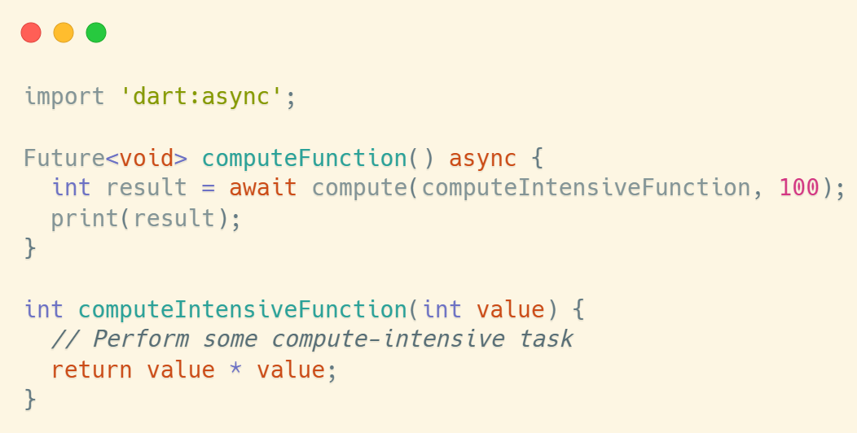
Advanced Techniques - Multithreading
Exception handling in multithreaded environments:
Synchronize access to shared resources to avoid race conditions.
Ensure thread safety when handling exceptions.
Notes:
Exception handling in multithreaded environments: Addressing the challenges and considerations for handling exceptions in concurrent and multithreaded applications.
Thread safety considerations: Discussing the importance of ensuring thread safety and synchronization in exception handling mechanisms.

Slide 7
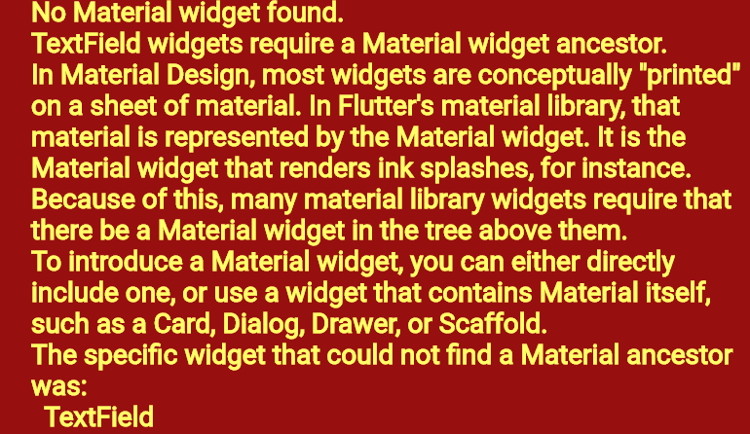
Real-world Examples & Pitfalls
Demonstrate different exception handling techniques in practical situations.
Discuss potential pitfalls and solutions for common errors.
Notes:
Practical demonstrations: Providing real-world examples and scenarios to illustrate effective exception handling techniques.
Discussing potential pitfalls: Identifying common mistakes and pitfalls in exception handling and proposing solutions to mitigate them.

Slide 8
Best Practices & Guidelines
Principles for robust exception handling:
Follow consistent and clear coding patterns.
Use descriptive exception messages.
Design for testability and maintainability.
Choosing the right approach:
Consider the context and severity of potential exceptions.
Choose appropriate try-catch blocks and exception types.
Balance clarity with efficiency.
Notes:
Principles for robust exception handling: Outlining best practices and principles for designing resilient and maintainable exception handling mechanisms.
Designing for maintainability and readability: Emphasizing the importance of clear, concise, and maintainable exception handling code.
Choosing the right approach: Providing guidelines for selecting the appropriate exception handling approach based on the specific requirements of the application.

